Slide 1
Predictive Model Construction for DM II
Junbin Sun : js09442p@pace.edu

Slide 2
Agenda
Introduction
Methodology
Experiments
Results and Conclusion
References

Slide 3
Introduction
Diabetes is a frequent metabolic disorder defined by chronic hyperglycemia, caused by a deficiency in the endocrine system.
Diabetes Mellitus Type II (DM II; adult onset diabetes) is associated most strongly with obesity.
predictor of diabetes : Waist to Hip Ratio / Body Mass Index (BMI)
predictive models have the potential to improve the diagnostics and treatment of patients.

Slide 4
Introduction…
In this research, we have carried out studies to find out the predictors of two outcomes :
Glycosylated hemoglobin
Diagnosis of diabetes
Dataset Used : Dr. John Schorling, Department of Medicine, and University of Virginia School of Medicine.
Data Consist of 19 variables on 403 subjects who where interviewed to understand the commonness of obesity, diabetes, and other cardiovascular risk factors.

Slide 5
Introduction…
Parameter tested : Glycosylated hemoglobin
The level of glycosylated hemoglobin depicts the average blood-glucose level over the past three months.
For any normal person, it is less than 7%.
Glycosylated hemoglobin > 7.0 is considered as a positive sign of diabetes.

Slide 6
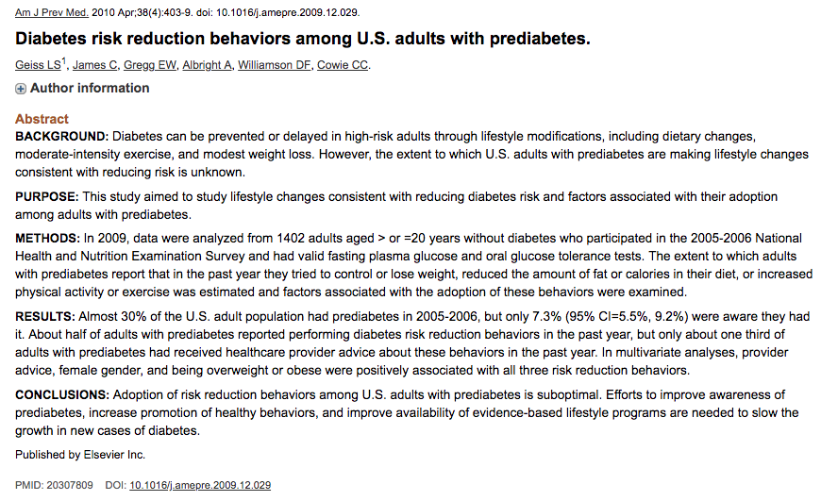
Literature Review

Slide 7
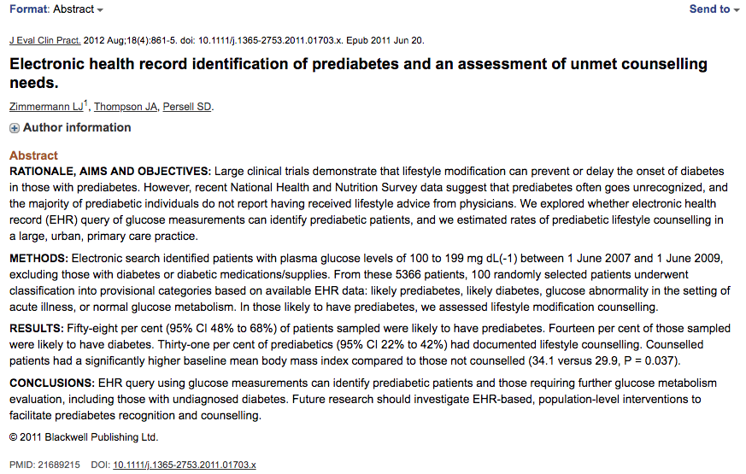
Literature Review

Slide 8
Methodology
Descriptive statistics: Mean value , standard deviation and correlation coefficient to get general overview of distribution of the variables.
Bivariate Analysis: To study relationship between the outcomes and the predictors by using visual plots and statistic hypothesis.
Pearson’s Chi-squared test: To study relation between categorical variables.
Regression Analysis: Performed on each outcome to analyze the residual pattern for fitted as well as theoretical quantities.

Slide 9
Experiments Conducted
Bivariate Analysis
Pearson’s Chi-squared test
Regression Analysis

Slide 10
Bivariate Analysis
Helps to analyze the relationship between two attributes.
Also, it helps to evaluate association between the variables and the significance of this association.
There are three types of bivariate analysis:
Numerical & Numerical
Categorical & Categorical
Categorical & Numerical

Slide 11
Bivariate Analysis
Variation of Glycosylated hemoglobin (Glyhb) with category predictors.
Variation of Glycosylated hemoglobin (Glyhb ) with continuous variables.

Slide 12
Variation of (Glyhb) with category predictors.
Here we study relationship of Glyhb with three different category predictor variables : Location , Gender and Frame
We carry out the categorical to categorical bivariate analysis to visualize the relationship between the above-mentioned categories

Slide 13
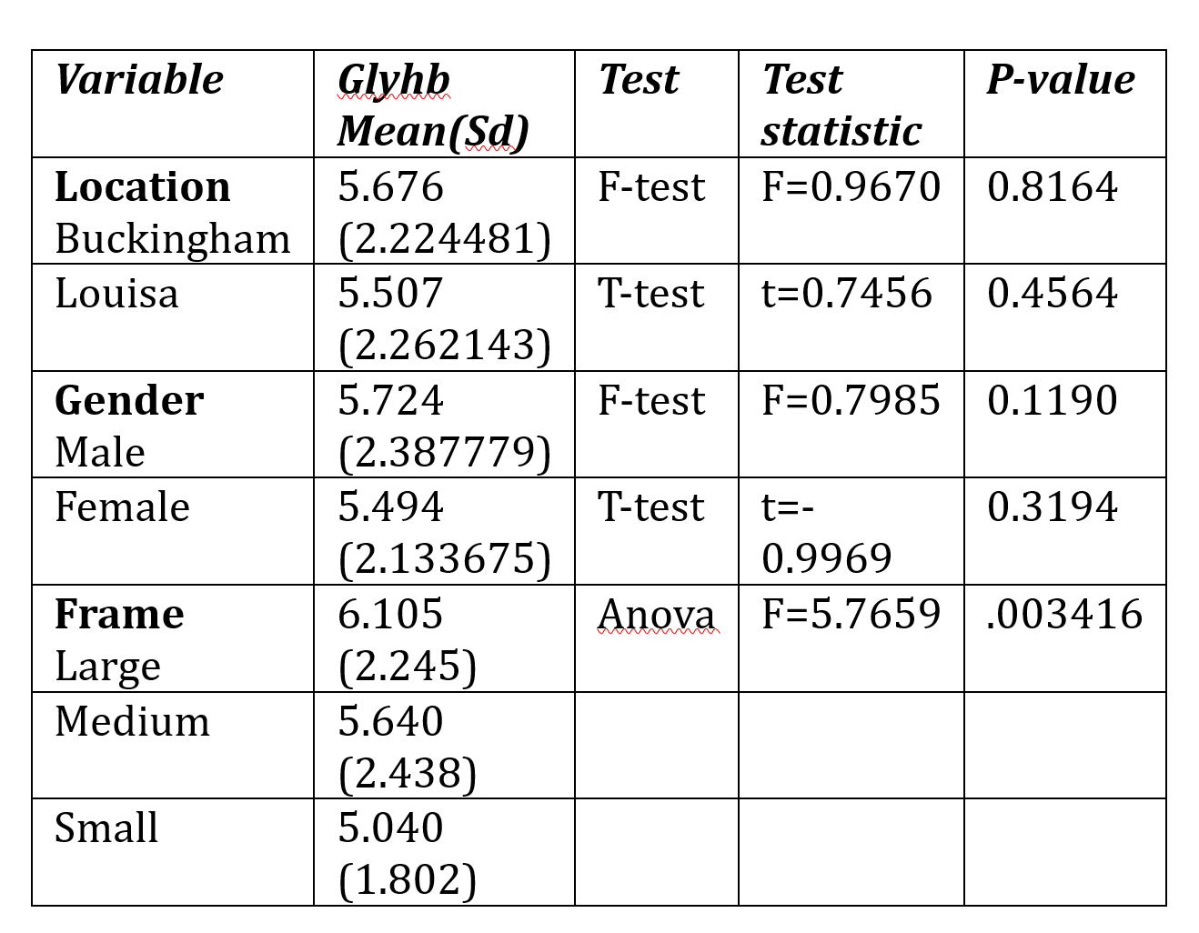
Variation of (Glyhb) with category predictors.

Slide 14
Variation of (Glyhb ) with continuous variables.
To conduct this experiment have used Numerical and Numerical Bivariate analysis.
Can be obtained by two ways
Scatter Plot
Linear Correlation
For our studies we considered 12 continuous predictor variables.

Slide 15
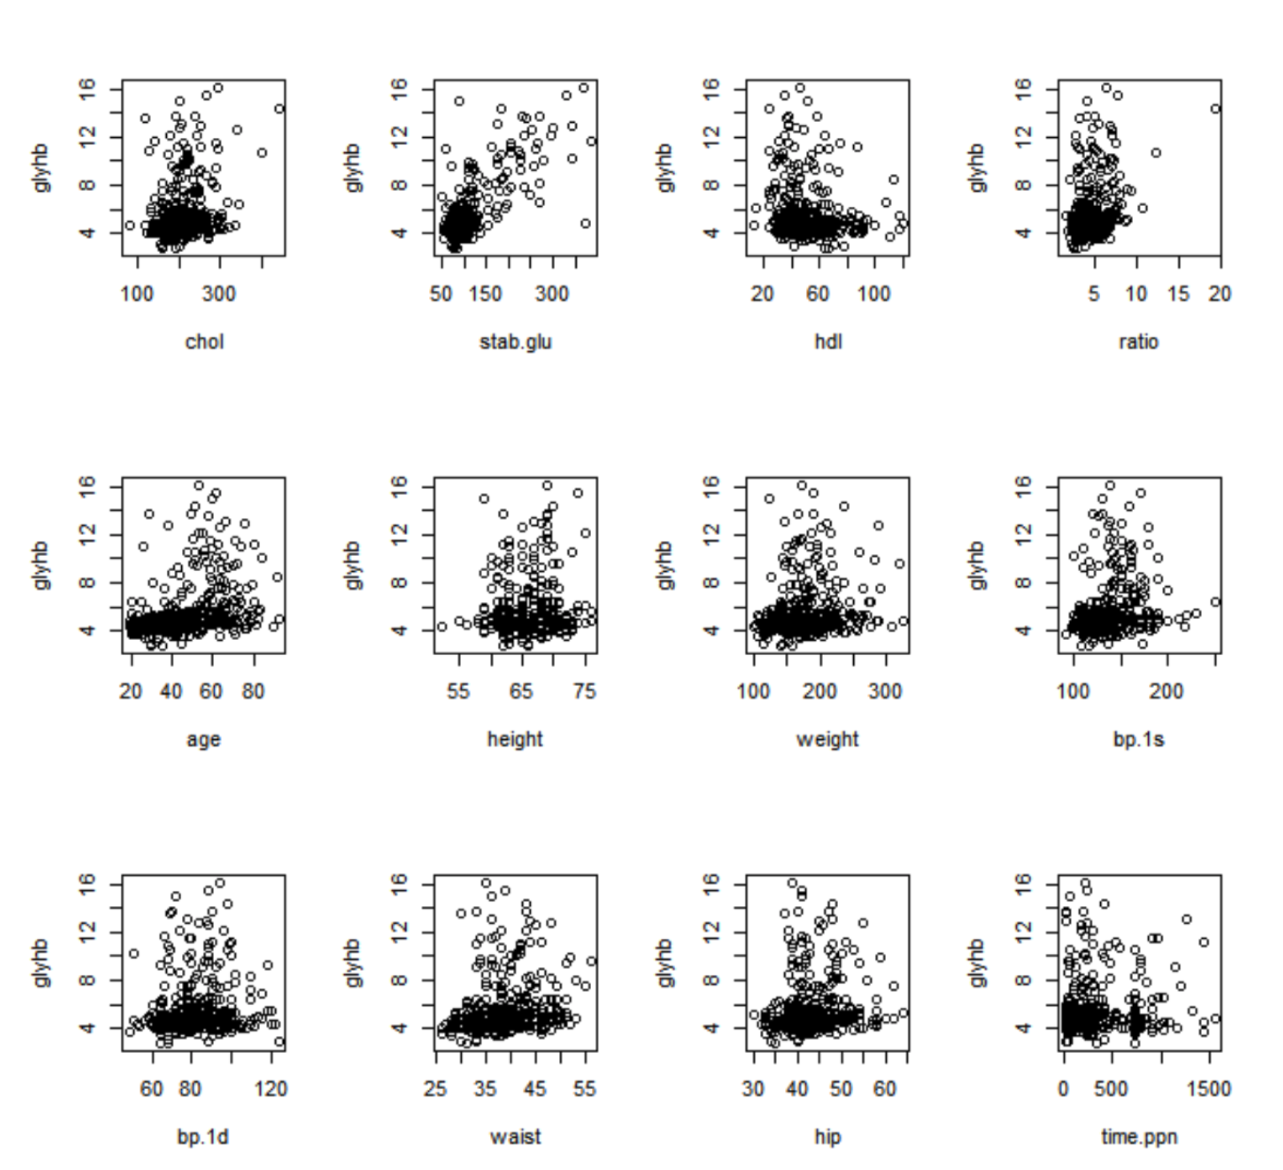
Variation of (Glyhb ) with continuous variables.
Scatter Plot :

Slide 16
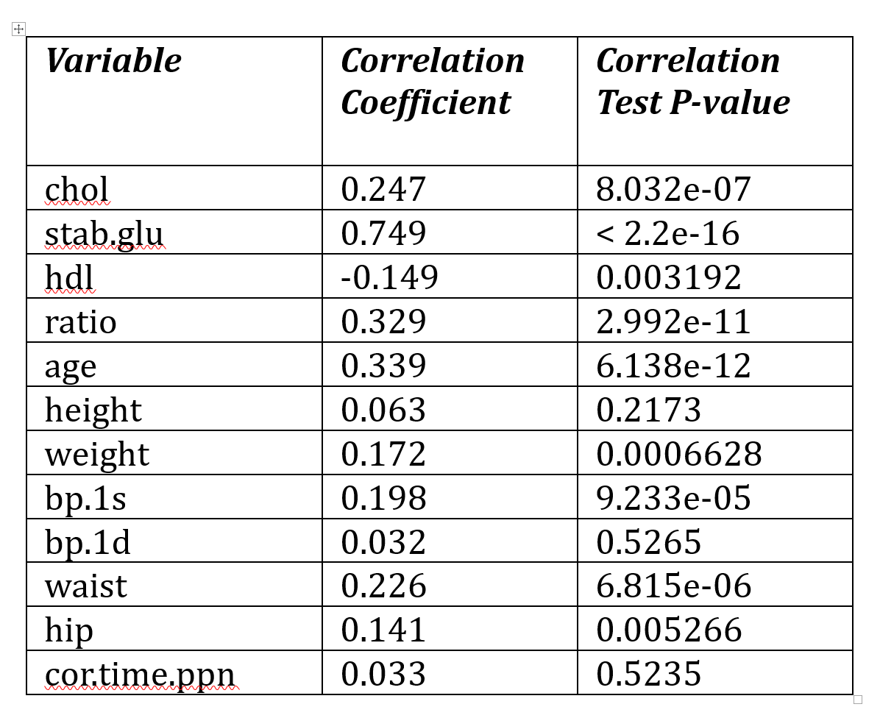
Variation of (Glyhb ) with continuous variables.
Linear Correlation :

Slide 17
Pearson’s Chi-squared test
Chi-square test relies on the difference between the expected and the observed frequencies in one or more categories in the frequency table, also known as the contingency table.
Hence, we have generated tables that make use of the category predictor variables.

Slide 18
Pearson’s Chi-squared test
Variation of Diabetes with the category predictors.
Variation of Diabetes with the continuous variables.

Slide 19
Variation of Diabetes with the category predictors
We generated three contingency tables that make use of the three category predictors: location, gender, and frame.
Apply Chi Square test to find dependency or independency between diabetes and three category predictors
The Chi-square distribution gives us a probability for the computed Chi-square and thus we were able to analyze the degree of freedom.

Slide 20
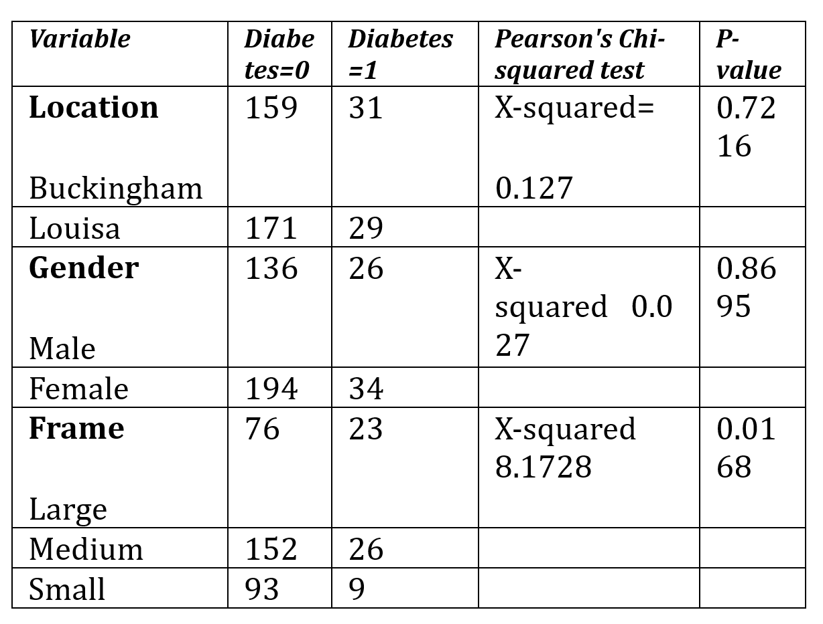
Variation of Diabetes with the category predictors

Slide 21
Variation of Diabetes with the continuous variables.
To analyze the relationship between the continuous variables and diabetes, we used two sample two tailed t-tests to compare if the average (mean) difference between the two groups (diabetes and each of the continuous variables) is significant or not
It also explained us whether the sample size is greater or less than a certain range whether the sample size is greater or less than a certain range of values and hence it gives the two sided critical area of distribution of values and hence it gave us the two sided critical area of distribution.

Slide 22
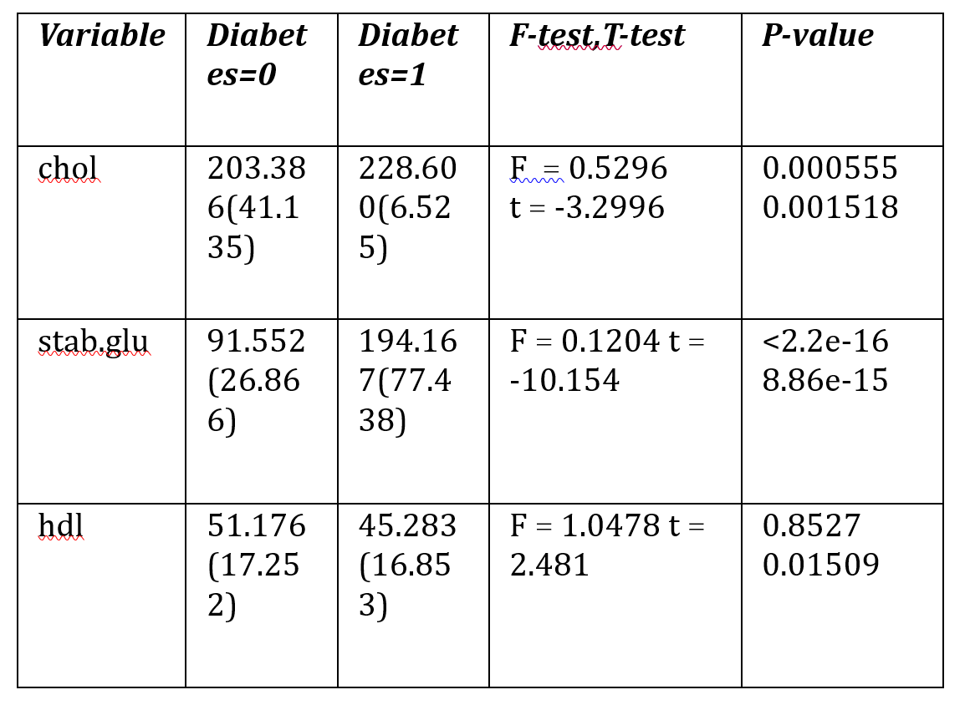
Variation of Diabetes with the continuous variables.

Slide 23
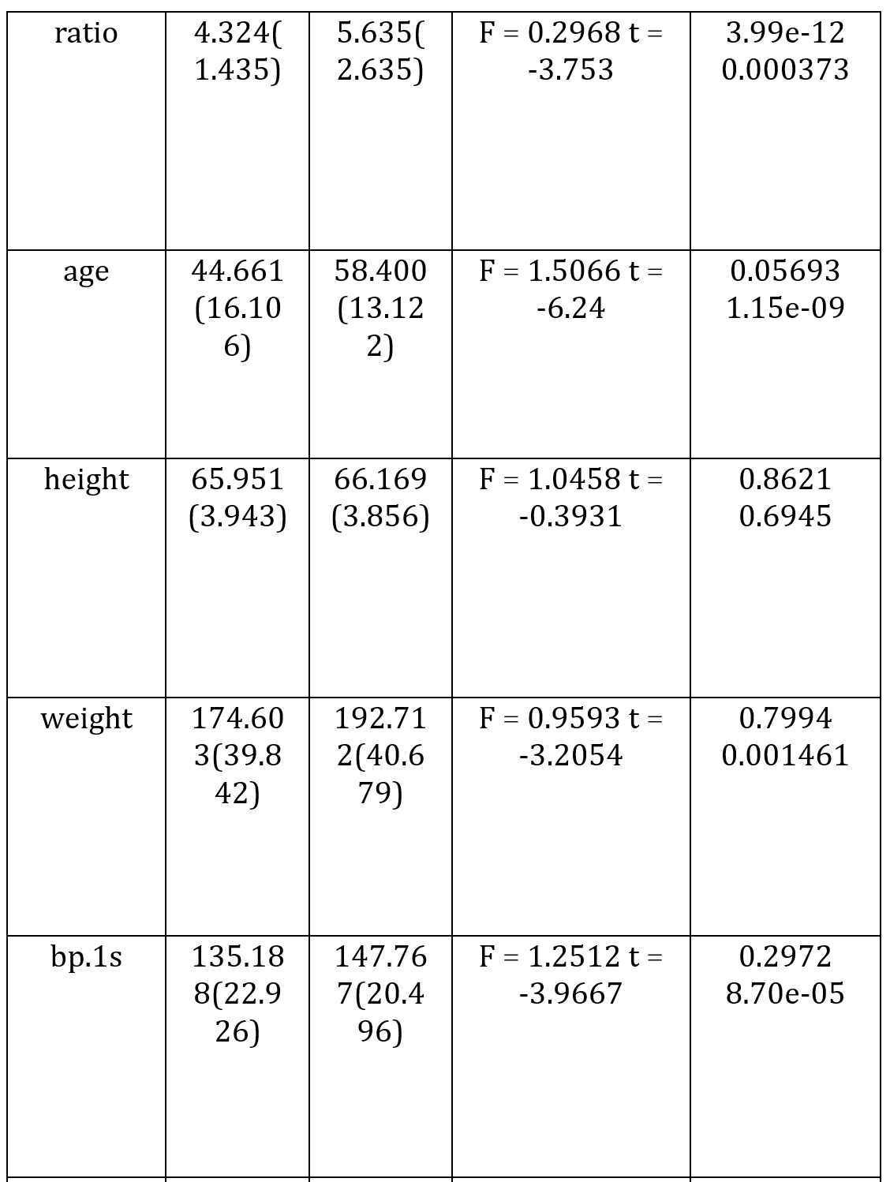
Variation of Diabetes with the continuous variables.

Slide 24
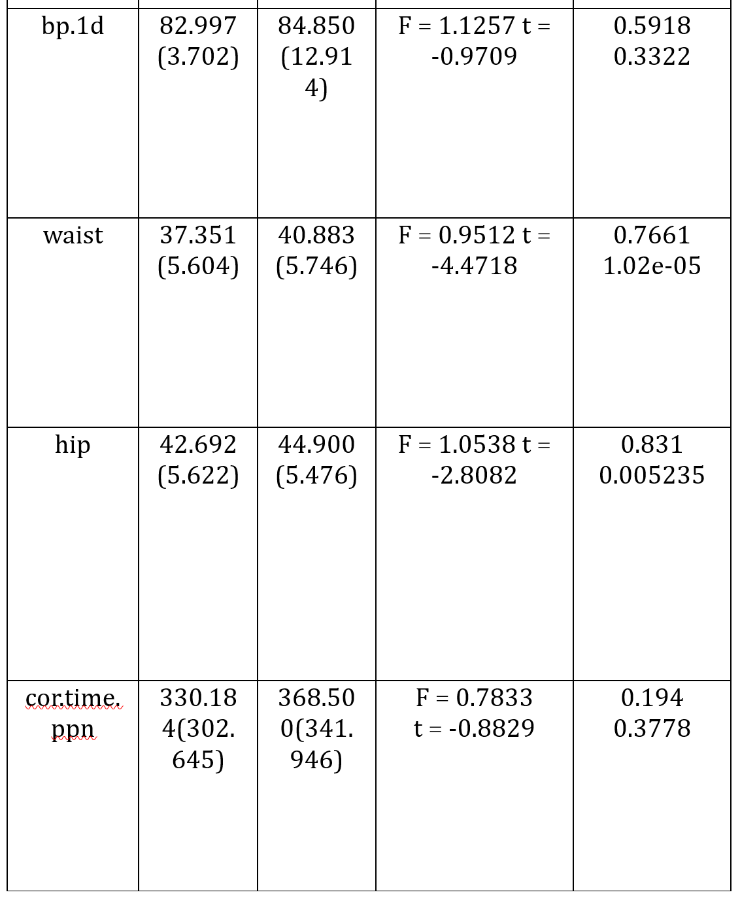
Variation of Diabetes with the continuous variables.

Slide 25
Regression Analysis
We Performed two regression analysis
linear regression : Glycosylated hemoglobin as the outcome
logistic regression : diagnosis of diabetes as an outcome

Slide 26
Linear Regression
First we used all the predictors to perform the regression with using Glycosylated hemoglobin as outcome response variable, then we removed five predictor’s and used the left over predictors to refit a linear model.
Then we applied a partial F test to test whether there is any difference between the reduced model and the full model.
If the test's p-value is 0.103 which is greater than 0.05, it means we cannot reject the reduced model at 0.05 level and consider that there is no significant difference between reduced model and the full model.

Slide 27
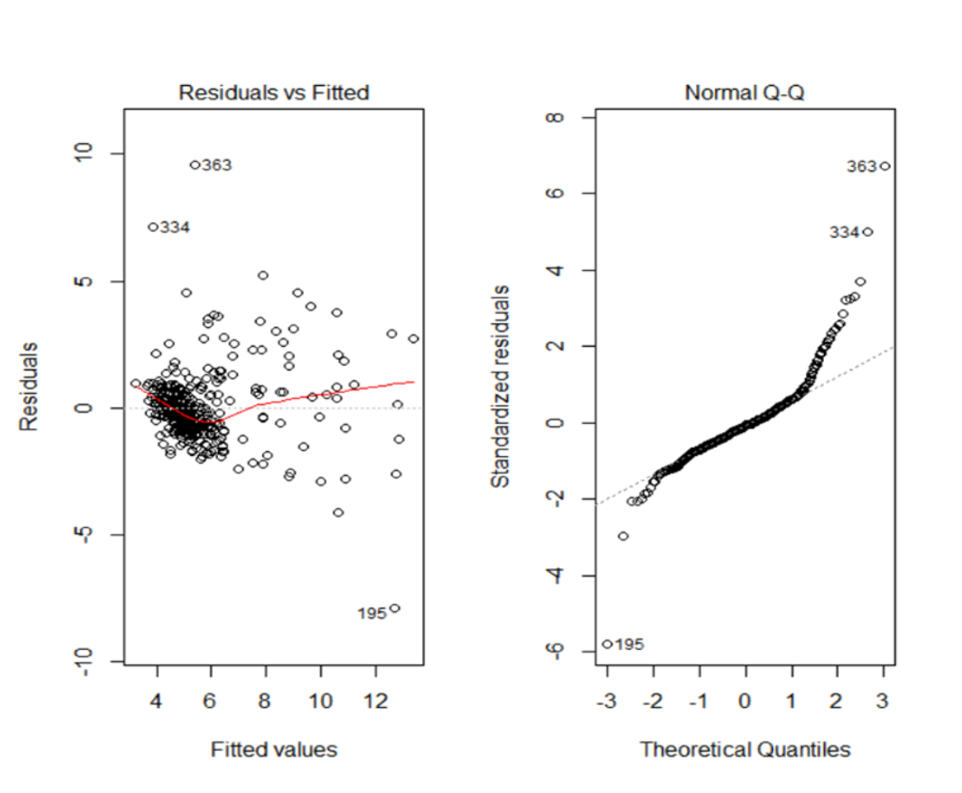
Linear Regression

Slide 28
Logistic Regression
We used the diabetes which is a binary variable as the outcome and perform a logistic regression.
Result of the logistic model showed us that stab.glu and age are significant variables.
Also it showed us that the accuracy achieved i.e. 0.928 is a rather high value , which means our logistic model is helpful predicting whether it is diagnosed with the diabetes or not.

Slide 29
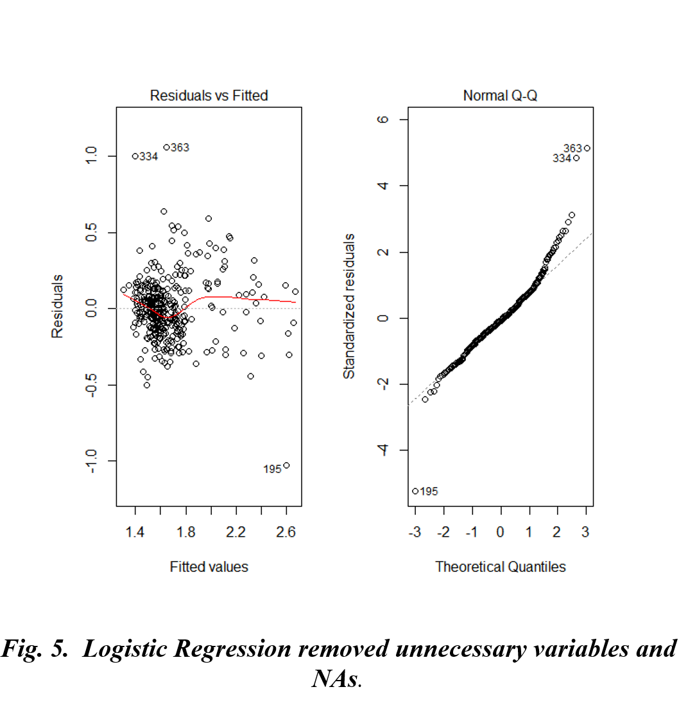
Logistic Regression

Slide 30
Logistic Regression

Slide 31
Building SVM Model
Fitting regression model – It is a logistic regression model between diabetes and variables to determine whether or not diabetes is a dichotomous variable.
here we record the probability of diabetes as P and P as a dependent variable to fit the logistic regression model.

Slide 32
Fitting Regression Model
Remove 5 Unrelated Variables.The sensitivity was 93.2% and the specificity was 85.7%. The correct rate is 92.3%
Step by step screening method selection variable. Finally selected 4 variables: cholesterol content, blood sugar content, waist circumference, age
P(diabetes)=-12.383+0.0086chol+0.651stab.glu+0.039age+0.026waist
3. Fitting a linear regression of glycated hemoglobin using six related variables.
log(glyhb)=0.794+0.0003chol+0.004stab.glu+0.0002hdl+0.17ratio+0.003age+0.005waist

Slide 33
Fitting Regression Model
Remove 5 Unrelated Variables. The sensitivity was 93.2% and the specificity was 85.7%. The correct rate is 92.3%
Step by step screening method selection variable. Finally selected 4 variables: cholesterol content, blood sugar content, waist circumference, age
P(diabetes)=-12.383+0.0086chol+0.651stab.glu+0.039age+0.026waist
3. Fitting a linear regression of glycated hemoglobin using six related variables.
log(glyhb)=0.794+0.0003chol+0.004stab.glu+0.0002hdl+0.17ratio+0.003age+0.005waist

Slide 34
Fitting Regression Model
A logistic regression of diabetes was performed using 6 related variables
P(diabetes)=-10.788+0.013chol+0.034stab.glu-0.024hdl-0.147ratio+0.036age+0.055waist

Slide 35
System design - Scoring Criteria
According to ratio of the correlation coefficient of the variable , assign score to each variable :
Cholestrol-1.57pt
high-density lipoprotein- 1 pt.
cholesterol high-density lipoprotein- 2.15pt.
Age-2.24pt.
waist circumference -1.54pt.
blood sugar content- 5pt.
Total – 13 points

Slide 36
System design - Scoring Criteria
It is judged that several indicators of the patient exceed the average value of the variable, and the scores corresponding to the standard variables are added to obtain a total score.
Normal population score is 0-2; low-risk group is 2-6 points; high-risk group is 6-10 points; 10 points or more are diabetic patients.

Slide 37
Result / Conclusion
From the two sample t test, we found that there is no significant difference in Glycosylated hemoglobin levels when varied with diferent levels of location and gender.
The results from the Pearson’s Correlation test showed us that the three predictors : height , bp1.d , time.ppn are insignificant in having any correlation with Glycosylated hemoglobin.
The Chi Square test indicate that location and gender are insignificant with diabetes as the outcome.

Slide 38
Result / Conclusion
The result of the t test indicate that the predicators: height, bp.1d and time.ppn are also insignificant in analyzing the variation of diabetes with continuous variables.
Thus, we perform regression analysis for Glycosylated hemoglobin and diabetes.
From Regression, we estimated that the coefficients of stab.glu and ages are significant in both the regression models and hence these two predictors are important factors.

